Slide 1


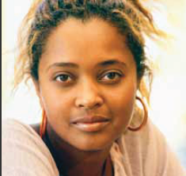
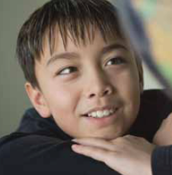
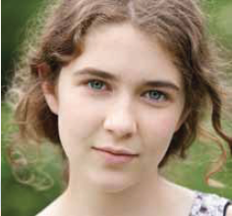
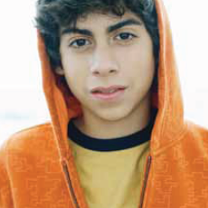

Putting the Health in Mental Health
Michelle Cassidy
Mental Health Lead
May 2016

Slide 2
All Kids Need to Experience and Practice…
Independence
Autonomy
Control
**makes sense given we are to release them to the world eventually, otherwise they would be dependent forever which would be dangerous for them in the world
Notes:
(mealtime, bedtime, potty training)

Slide 3
How do we help them on their path towards becoming adults?
What does it mean to promote their mental health and happiness?

Slide 4
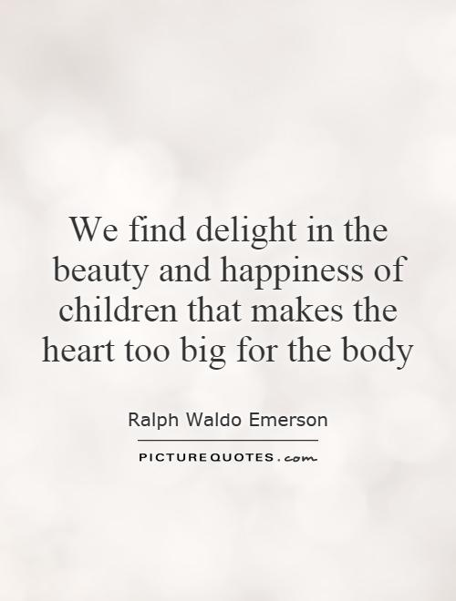

Slide 5
Happiness..Elisha Goldstein
Eudemonic Happiness:
meaning
purpose
connection

Slide 6
The Brain’s Job
Survival

Slide 7
Designed to keep our body in balance
Our body craves homeostasis
The brain supports adaptive functioning
It is hardwired to protect us
Notes:
Cassidy

Slide 8
Why is this important?
Flight,
Fight,
or
Freeze
Notes:
Cassidy

Slide 9
A Helpful Brain Model
Dr. Daniel Siegel
Notes:
CASSIDY

Slide 10
What happens in the body..why traditional ways of responding don’t work
Hippocampus attuned to threat
Pre frontal cortex is shut down, reasoning is not possible
Organs divert energy to survival needs
Hearing shifts to attune to low frequency sounds only

Slide 11

How can we as parents help?

Slide 12
Changing the Brain
We need our brain to have the alarm system, we wouldn’t want to turn if off BUT higher level cortical functions help us moderate it
Plasticity allows us to strengthen how the brain regulates
Notes:
CASSIDY
Negativity bias
Attachment
Startle response

Slide 13
7 Secrets of
Highly Happy
Children
Adapted from:
Katie Hurley,Huffington Post

Slide 14
Eat on Time
(and connect as a family)

Slide 15
Family Mealtimes
Schedule them if you have to
No technology, including answering the phone
Structure the conversation, must be positive
Devote one meal month to each family member (choice of meal, pick the positive conversation starter, and 1 affirmation)**identity development

Slide 16
Family Dinner

Slide 17
Consistent
Sleep
Notes:
Sleep is a key protective health factor

Slide 18
Disregulated Sleep
2 types of sleep:
Restorative sleep
Non-restorative sleep
Large increase in children, youth and adults getting primarily non restorative sleep…
3 primary factors:
Lack of physical activity
Blue Light
Stress/Anxiety

Slide 19
Bedtime Routine
Forgiveness
Being grateful: thanking people for the things they have brought into your life
Structured Relaxation
E.g. worried about homework
“What are you struggling with? What do you want to feel tonight?” e.g. safety, peace
Body Scan for Sleep
Progressive Muscle Relaxation
4-7-8 Breathing

Slide 20
Play without
Instructions

Slide 21
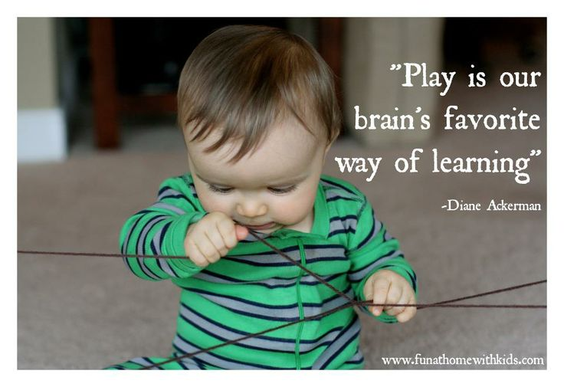

Slide 22
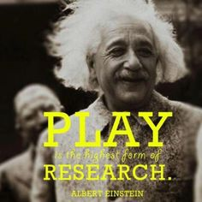

Slide 23
Get the body moving
(full range of motion activities, tension and release)
Get outside~
Nature

Slide 24
Allowed to
Express
Emotions

Slide 25
Brain Confusion
Fear vs. Anxiety

Slide 26
Support Helping them Regulate Emotions…not Deny them
Begins with SELF AWARENESS
What does it feel like when you feel “icky” or “anxious”?
Spiders crawling up arms…knots in stomach etc.
Label emotions when speaking to younger children
Teach them about “flipping their lid”

Slide 27
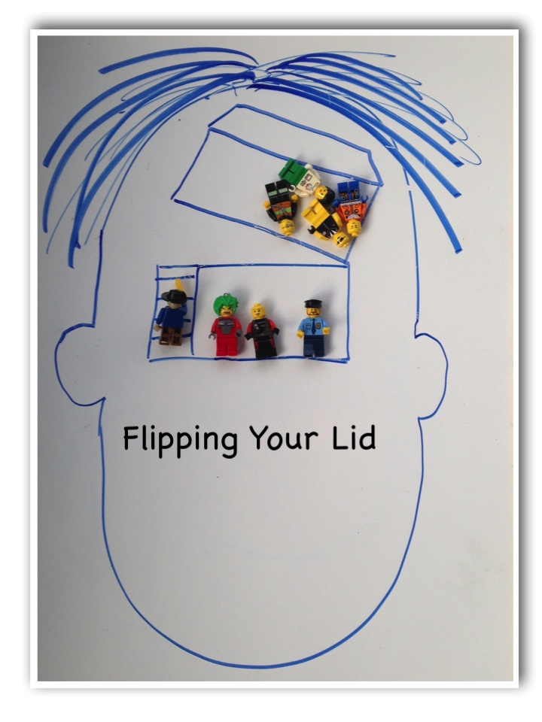

Slide 28
BMW
(@%#$^@...moan…and whine) and then
RESTORE

Slide 29
Here’s what it looks like…
Just Breathe

Slide 30
Woohoo
Elisha Goldstein
Procedural Memory
When making a mistake, send a message to the brain that this is okay…it is just learning
F-first
A-attempt
I-in
L-learning

Slide 31
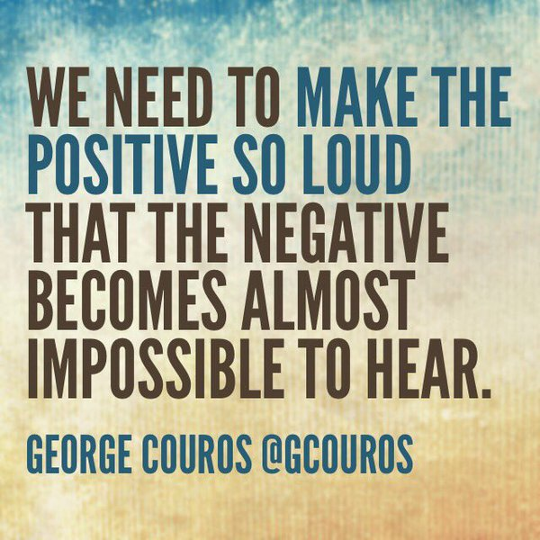

Slide 32
Make
Choices
(control, autonomy, independence)

Slide 33
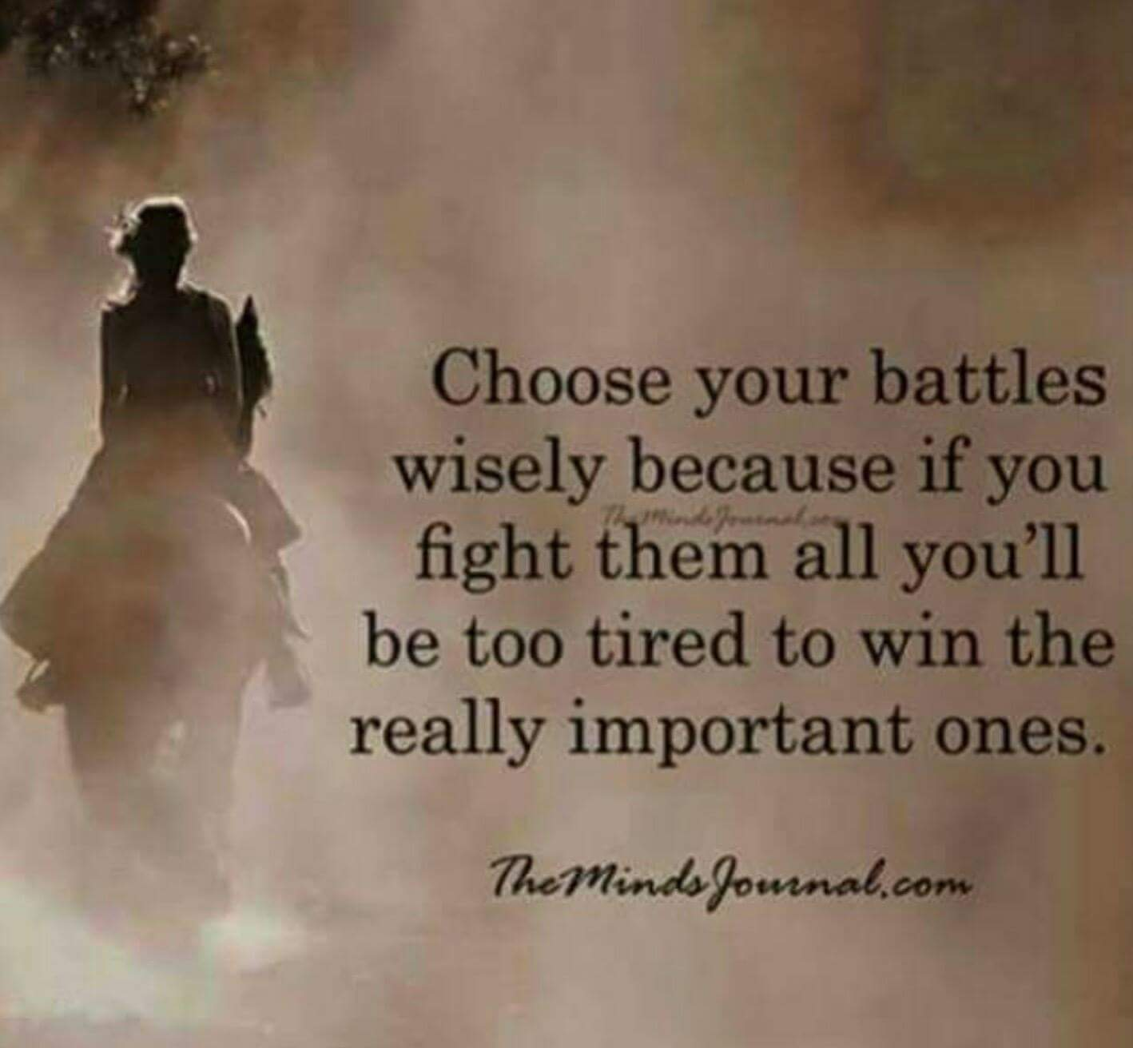

Slide 34
Choose : What’s your thing?
Each member of the family
What is the
number one thing
that, if I started doing it,
would have the
biggest
positive impact
on my life?
(on their life?)

Slide 35
Choose the FOCUS of our thoughts and behaviour
Gratitude lists
Values anchor: connect with 3 things you deeply love
Joy list
Calm, AOK, Gratitude

Slide 36
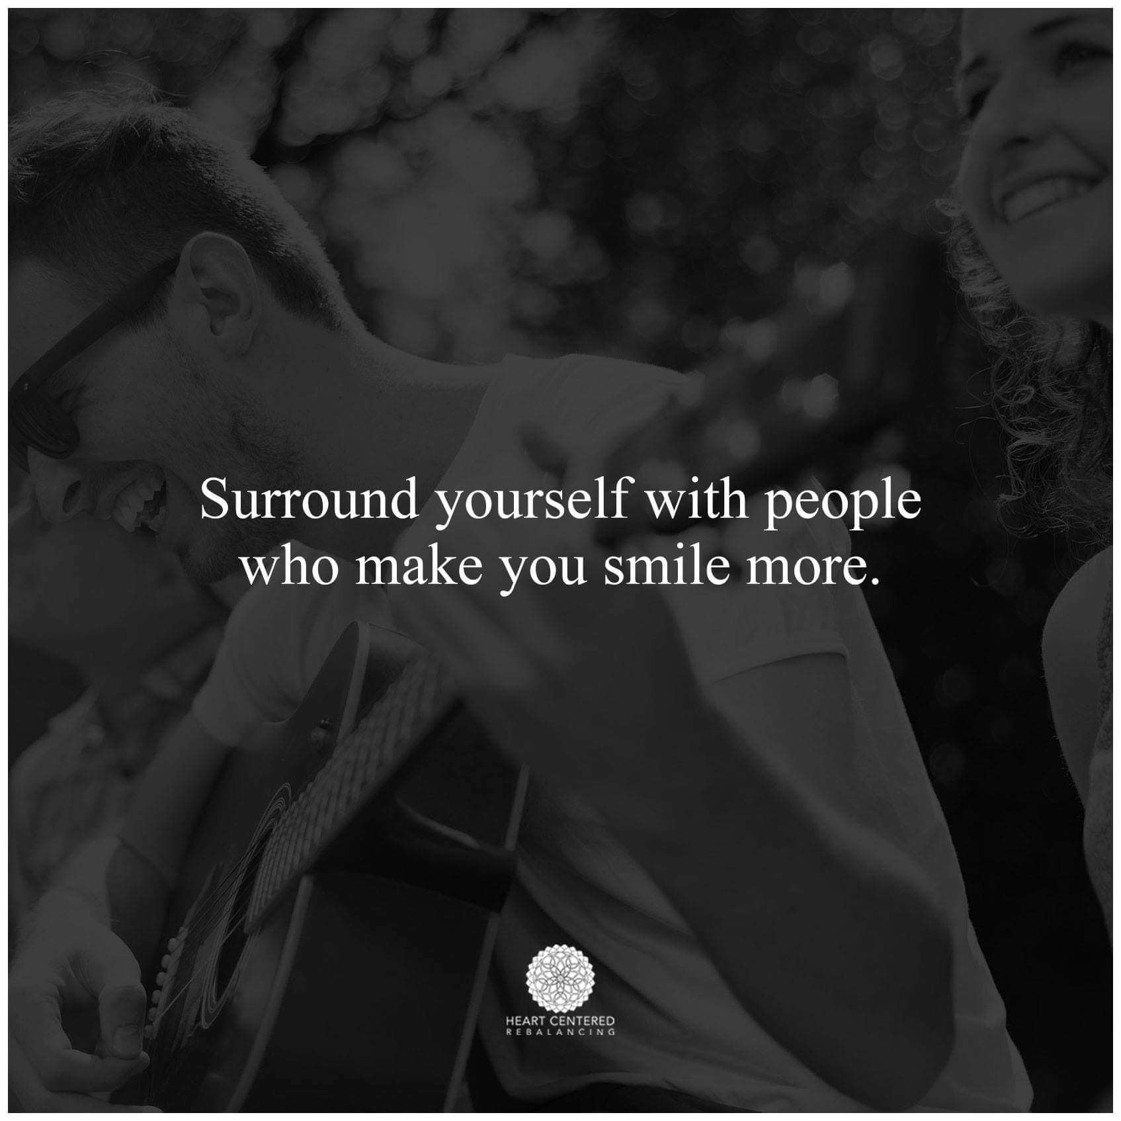

Slide 37
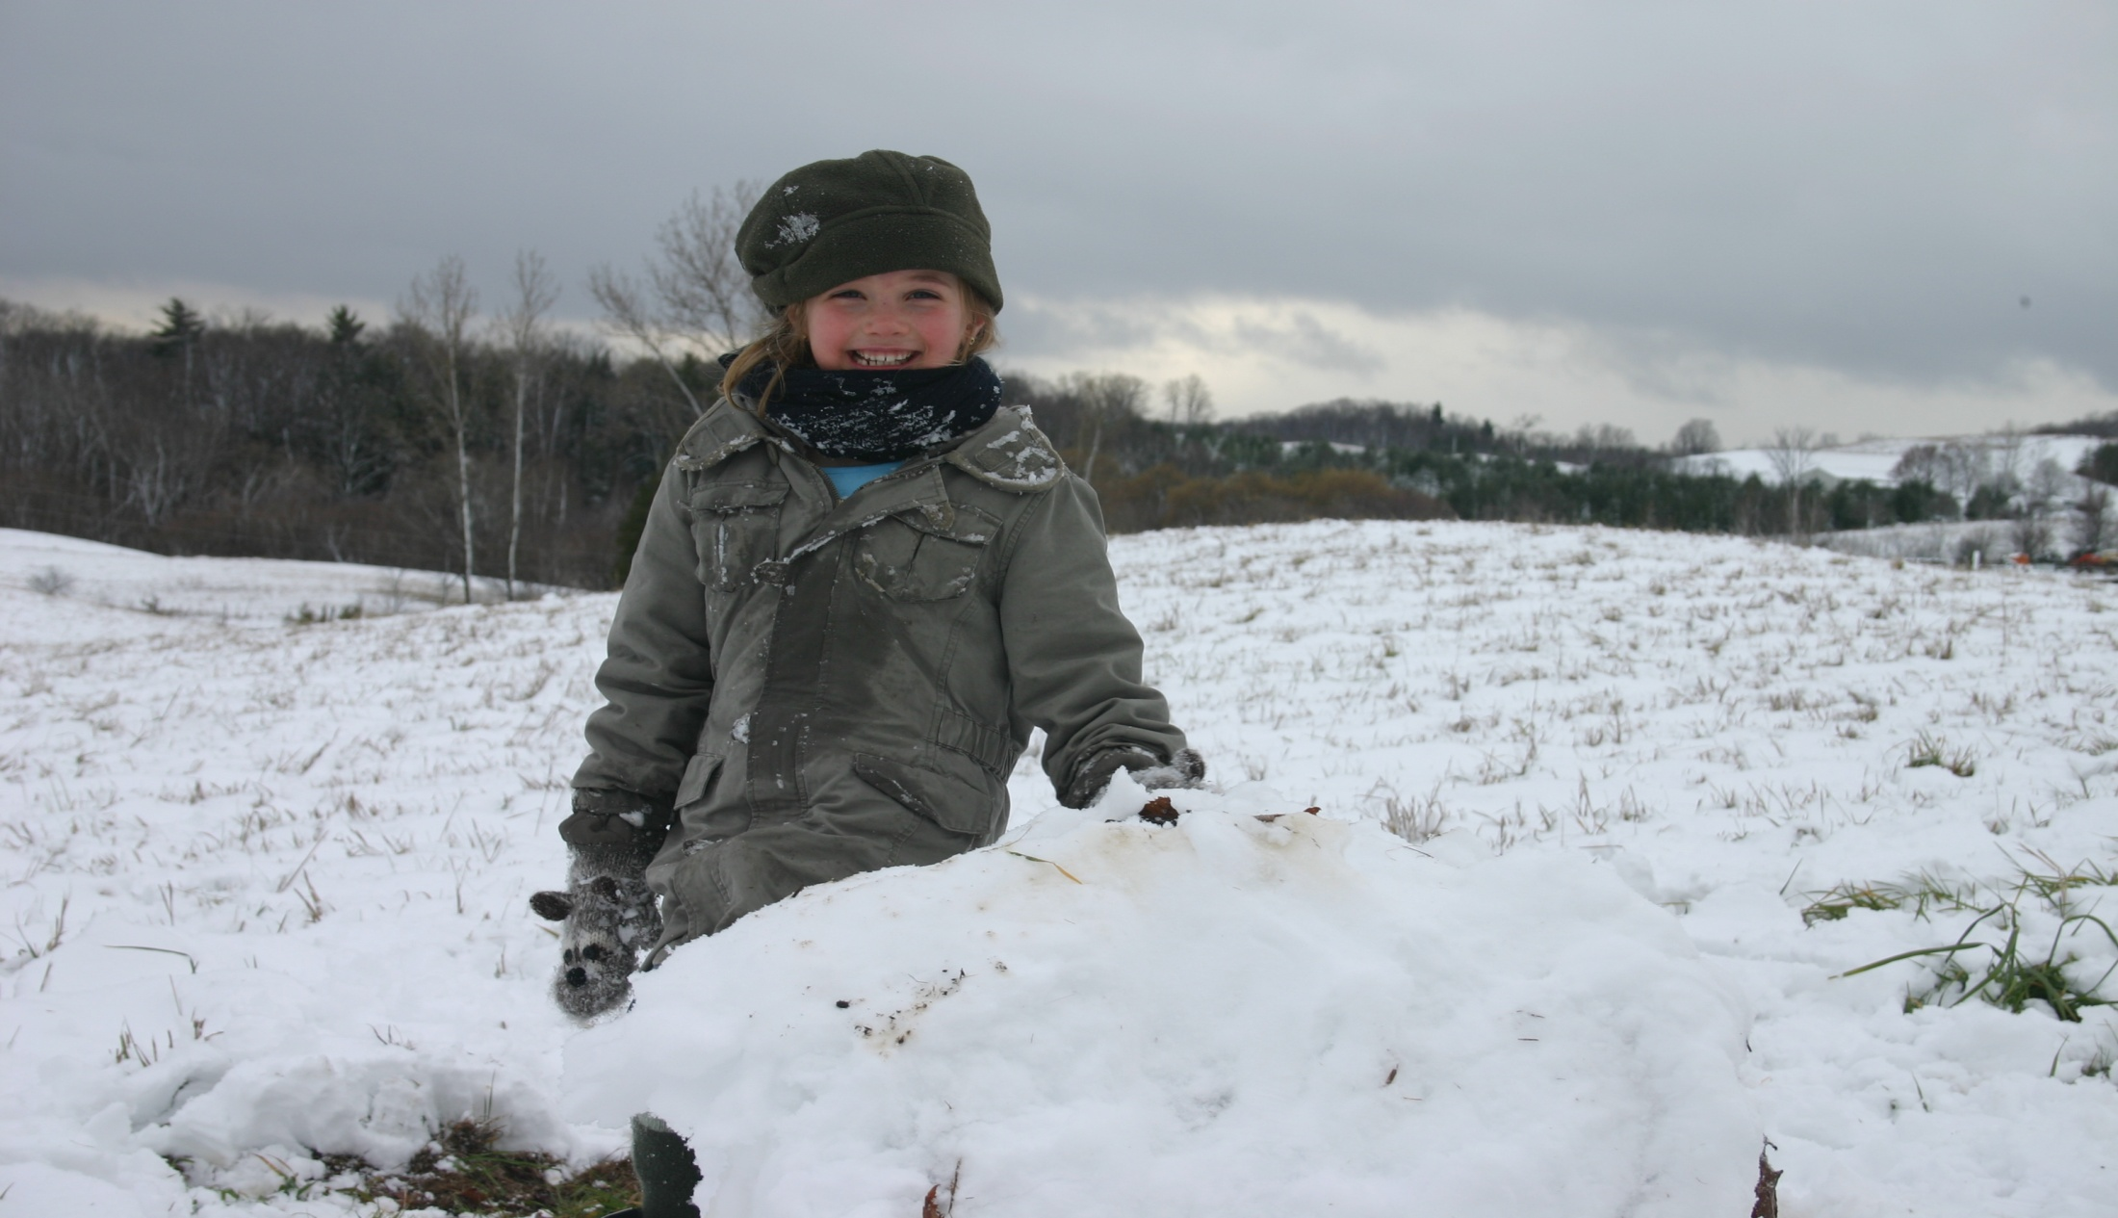
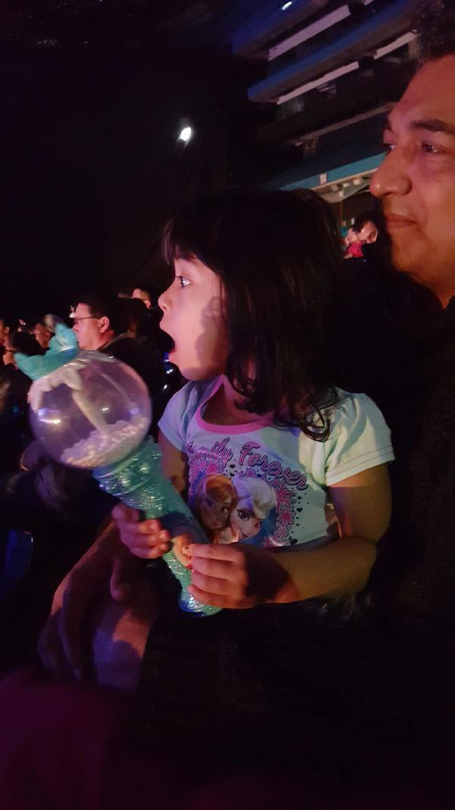
Choose to be in the moment
Mindfulness Through their Eyes

Slide 38
Feel
Heard
(and Understood)

Slide 39
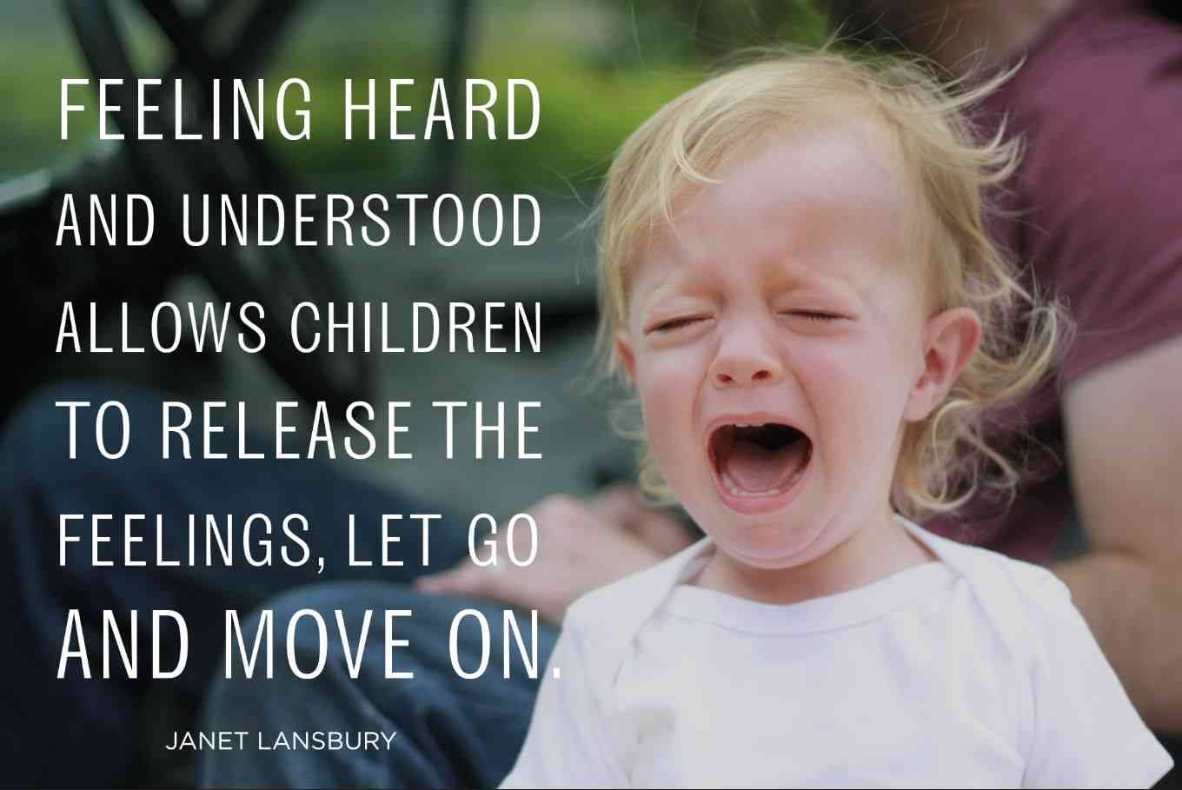

Slide 40
As a parent are you mindfully aware?...
Checking in….
Is your mind where your body is?

Slide 41
Understanding
Key to the relationship
Who they are as a person? Observe them…just watch
e.g. Introvert/Extrovert, HSP, thrive in chaos or peace

Slide 42
Experience
Unconditional
Love

Slide 43
Unconditional love
From YOU… but also themselves

Slide 44
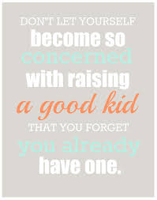

Slide 45

Self Compassion
Not about judging ourselves positively, but a way of relating to ourselves kindly, embracing ourselves lovingly flaws and all

Slide 46
If the day ever came when we were able to accept ourselves and our children exactly as we are and they are, then, I believe we would have come to an understanding of what "good parenting" means.
Fred Rogers

Slide 47
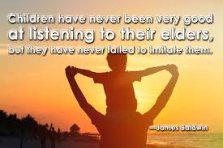

Slide 48
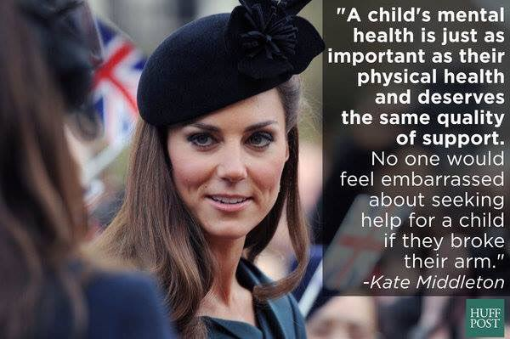
Last but not least…

Slide 49
Places to start..
Family Doctor
Child’s teacher/school
Flyers Parent’s for Children’s Mental Health (PCMH)
Mental Health Navigator (age 13-24 yrs.)

Slide 50
Resources
Websites:
Parents for Children's Mental Health
Anxiety BC
Anxiety BC Parent Toolkit
Mind Your Mind
Books:
Building Emotional Intelligence (Linda Lantieri)
Flourish (Dr. Seligman)
The Mindful Child (Susan Kaiser Greenland)
Brainstorm: The Power and Purpose of the Teenage Brain (Daniel Siegal)
The Highly Sensitive Child: Helping Our Children Thrive When the World Overwhelms Them (Elaine Aron)
Keys to Parenting Your Anxious Child, (Dr. Katharina Manassis)
Worried No More, Second Edition: Help and Hope for Anxious Children (Aureen Wagner)
Freeing Your Child From Anxiety, (Tamar Chansky)
Helping Your Anxious Child (Ronald M. Rapee)

